Slide 1
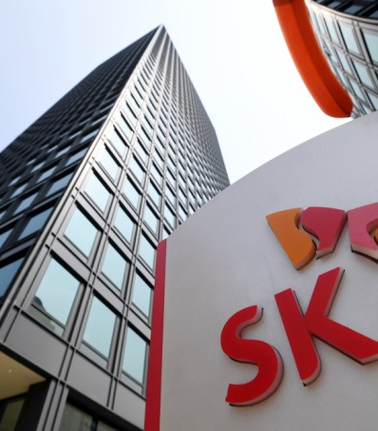
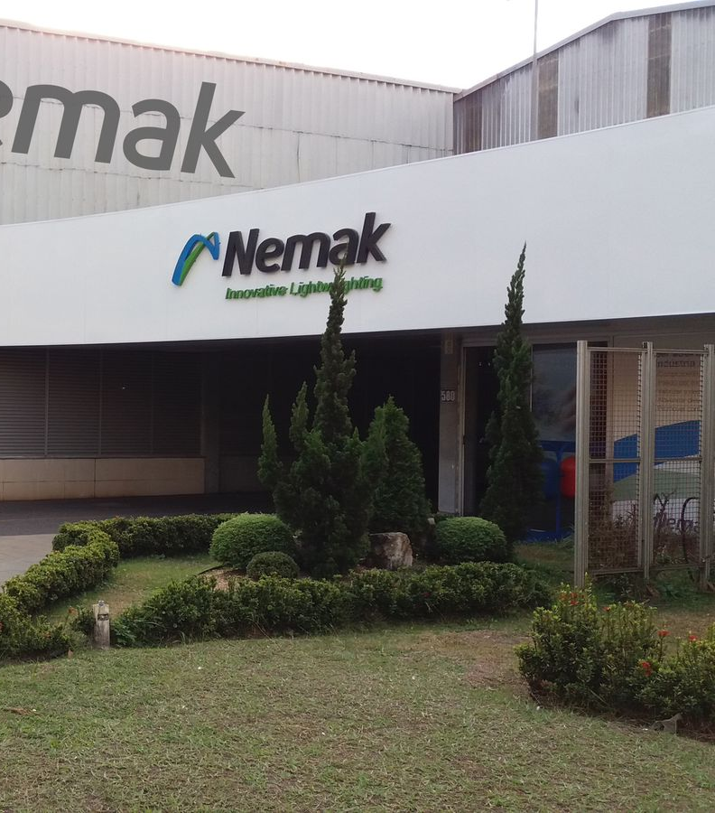
{COMPANY NAME}
{MONTH} - {YEAR}

Slide 2
{COMPANY_NAME} - Company Overview
``` Primary industry | Travel & tourism | FY23 strategic report | Incorporation year | 1999 | Certificate of incorporation | Headquarters | London, United Kingdom | FY23 accounts, p.1 | Employees (head-count) | 337 | FY23 note 7 (“Employees”) | Operational KPI – B2B group tours operated (FY23) | 4,950 tours | FY23 strategic report | Operational KPI – Passengers served (FY23) | 145,000 pax | FY23 strategic report | Operational KPI – Source markets served | 21 markets | Company website ```
Business Overview
Revenue Split (FY24)
Financial Highlight (FY22-24)
```text 2. BUSINESS OVERVIEW (bullets) • Tour Partner Group Limited acts as the intermediate holding and central treasury company for a pan-European collection of inbound group-tour operators trading under the “Tour Partner Group” banner. • The company owns operating subsidiaries in the United Kingdom, Ireland, Denmark, Germany and the United States that specialise in customised group travel programmes for leisure, MICE and special-interest clients. • The group trades primarily under the brands “Hotels & More”, “Irish Welcome Tours”, “Authentic Vacations” and “Trans Nordic Tours”, giving it direct contracting capability across the UK/Ireland and the Nordics. • It delivers end-to-end tour solutions – contracting accommodation, transport, attractions and guides – and packages them for wholesale partners, tour operators and online travel companies worldwide. • The company emphasises high-touch customer relationships, citing regular “listening events” and digital engagement platforms to tailor product and service enhancements to client feedback. • It reports that FY23 trading returned to pre-pandemic levels with a “strong order book group-wide” for 2024, supported by new offices opened in Edinburgh and Copenhagen and continued IT investment in remote working and cyber-security. ```
```text ------------------------------------------------------------------------ 3. REVENUE SPLIT – NOT DISCLOSED The FY23 statutory accounts contain only holding-company cost-recharge income (€4.4 m) and do not provide a consolidated or segmental revenue breakdown. Management states that the wider Tour Partner Group achieved “pre-pandemic levels” of activity but no numerical disclosure is provided. Source: FY23 accounts, note 3. ------------------------------------------------------------------------ ```
| Metric | FY21 (€ m) | FY22 (€ m) | FY23 (€ m) | |-------------------------------------|-----------|-----------|-----------| | Revenue | 0.0 | 0.0 | 4.4 | | Gross profit | n/a | n/a | n/a | | EBITDA | (1.9) | (2.1) | (6.5) | | Revenue growth | – | 0 % | n/m | | Gross margin | n/a | n/a | n/a | | EBITDA margin | n/m | n/m | n/m | | Operating cash flow | (2.0) | (2.2) | (6.1) | | Net working capital | 0.2 | 0.1 | 0.1 | | Taxes paid | – | – | – | | Capex | – | – | – | | Other investing cash-flow | – | – | – | | CFADS | (2.0) | (2.2) | (6.1) | | Cash flow from financing | 2.1 | 2.5 | 4.2 | | Opening cash | 0.1 | 0.2 | 0.5 | | Change in cash | 0.1 | 0.3 | (1.9) | | Closing cash | 0.2 | 0.5 | 2.4 | | Total debt (intra-group) | 3.1 | 0.6 | 4.8 | | Net debt | 2.9 | 0.1 | 2.4 | | Leverage (Net Debt/EBITDA) | n/m | n/m | n/m |
Headline revenue materialised only because the company began billing €4.4 m of head-office recharges in FY23, yet gross-profit data remain absent; meanwhile EBITDA plunged to a €6.5 m loss due to sizeable one-off restructuring and advisory costs plus a €0.8 m FX swing. Net working capital stayed neutral as group receivables mirrored payables, the holding entity itself booked zero capex, and its operating cash-burn was entirely covered by a €4.2 m on-demand loan from the parent. As a result, intra-group debt rose to €4.8 m and net debt to €2.4 m, but leverage ratios are meaningless given negative EBITDA.
Key Recent Developmentsa
Manufacturing Footprint
Key Recent Developments
Geographical Footprint
Capital Structure Summary (as of Dec-24)
| Metric | Value | |-----------------------|--------------------------------------------------------------------------------------------------------------------------------| | Top shareholder | Tour Partner Group Holdco Ltd (Guernsey) – 100 % | | Chairman | Mr Ian Grant | | CEO | Mr James Aitken | | CFO | Mr Duncan McCubbin | | Lenders / MLAs | n/a – no external bank borrowings disclosed; only intra-group balances with parent | | Auditor | BDO LLP (re-appointed Jun-24) | | Charges (UK) | None outstanding or registered at Companies House |
Tour Partner Group Limited’s capital structure is both simple and fragile: the company is funded almost exclusively by an unsecured, on-demand shareholder loan from its Guernsey parent, which rose by €2.6 m in FY23 to €4.8 m and lifted net debt to €2.7 m. There are no third-party borrowings, no committed bank lines and therefore no leverage or financial covenants to monitor, but the repay-on-demand feature of the parent loan creates a latent “spring-ing default” risk—if the parent were to call the loan, the holding company would face an immediate liquidity shortfall. Liquidity currently consists of just €2.4 m cash with no undrawn facilities, so continued solvency depends entirely on the parent’s willingness and capacity to keep providing funds, especially during seasonal working-capital peaks flagged in the strategic report.
Key Stakeholders
```markdown ------------------------------------------------------------------------ 6. KEY STAKEHOLDERS | Category | Stakeholder (& % / role) | Source | |----------------|--------------------------|--------| | Top shareholders | Tour Partner Group Holdco Ltd (Guernsey) – 100 % | FY23 note 24, Companies House PSC register | | Management | Chairman – Mr Ian Grant; CEO – Mr James Aitken; CFO – Mr Duncan McCubbin | FY23 directors’ report | | Lenders / MLAs | n/a – no external bank borrowings disclosed; only intra-group balances with parent | FY23 note 15 | | Auditor | BDO LLP (re-appointed Jun-24) | Independent auditor’s report, FY23 | | Charges (UK) | None outstanding or registered at Companies House | CH “Charges” tab | ------------------------------------------------------------------------ ```
Sources: Company financial statements, Company website, Debtwire, CIQ, Bloomberg, News
Notes: 1) Advisors to the company; 2) The values for LTM 1Q25 is not included in the financials table as the update does not provide detailed cash flow data; 3) Excluding net working capital and taxes paid

Slide 3
Organisational Structure
Organisational Structure
Organisational Structure
Ultimate Parent
Operating Subsidiary
Focus Company
Debt

